Slide 1
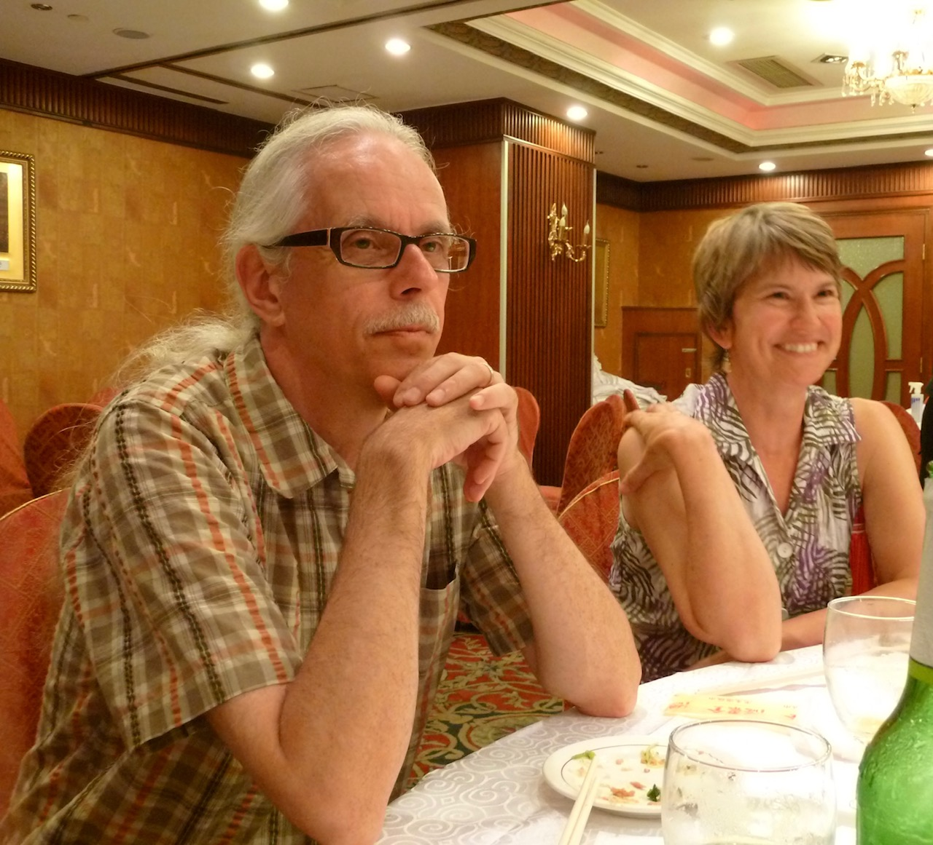
The Pragmatic Philosopher
The Servant Leadership of Professor Glen Carruthers

Slide 2
“Glen realized he had an intuitive flair for administration
(many would say he was genius at it)”
--WLU Obituary, December, 2020

Slide 3
Servant Leader Theory--Definition
“The servant-leader is servant first; it begins with a natural feeling that one wants to serve, to serve first. Then, conscious choice brings one to aspire to lead.
The best test is: do those served grow? Do they, while being served, become healthier, wiser, freer, more autonomous, more likely to become servants themselves?”
--Robert Greenleaf, 1970

Slide 4
“Agency, acquired and honed as students, empowers professional musicians to make effective choices that will buffer and ease inevitable career transitions.”
--Dr. Glen Carruthers, 2018

