Slide 1
Multi-stylism in portfolio careers:
Just below the surface…
How do musicians develop their multi-stylistic competences?
How do they navigate their careers?
What kinds of factors motivate professional engagement across multiple musical styles?
What can they teach us about ‘versatility’ in portfolio musicianship?
Portfolio musicianship:
Versatility as concurrent engagement across multiple “specialist fields” (Bennett, 2012, p. 8)
Entrepreneurship and career readiness (Burland & Bennett, 2022; Canham, 2021)
Assimilating diverse skill sets and creativities (Zhukov, 2019; Burnard, 2019)
Versatility of role as a mitigator of career precarity
What about versatility of musical style in career/lives?
Musicians already work across multiple styles of music
68% (of 554) reported engaging in multiple genres (Bartleet et al, 2020, p. 29)
98% (of 250) reported having worked in between 2-9 (Tolmie, 2017, p. 190)
Also present in HE students (Isbell & Stanley, 2017)
Notes:
CEPROM’s very own Diana Blom, Dawn Bennett

Slide 2
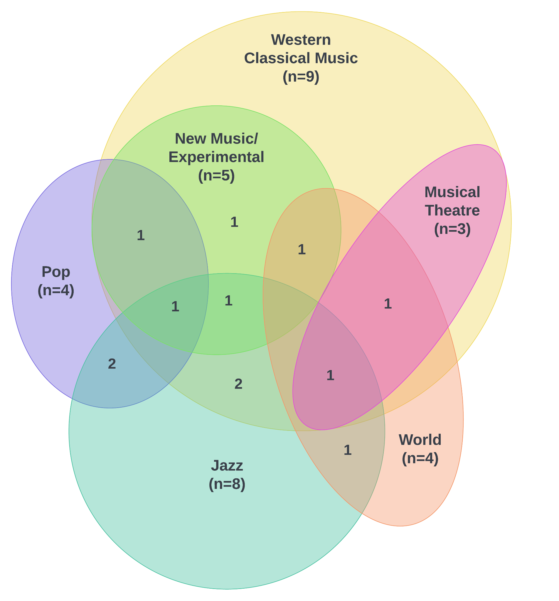
Life-histories and career practices of multi-stylistic professional musicians.
Methodology
Life History interviewing (see Palmer & Baker, 2021; Eros, 2018)
3 interviews per participant (Seidman, 2006)
Thematic Analysis (Terry et al., 2017)
Research Questions
What kinds of broad and situated learning experiences foster multi-stylistic musical competence?
What are the elements that facilitate a multi-stylistic musical career?
How can multi-stylistic musicians inform current understandings of portfolio careers in music?
Learning experiences
Self-led aural learning activities (transcription/ ear learning, improvisation) developed transferable musical skill sets
Mentors and teachers offered and encouraged diverse group learning opportunities (e.g., jamming and giggin with peers) and assisted with goal setting
Established Professional Networks
Networks assisted in attaining both on-going and new, multi-stylistic work
Depping/fill-in work was the catalyst to multiple long-term engagements e.g., orchestral, regular tours, permanent member of ensemble
“I’ve realised that a lot of performance work comes from people knowing of you and being on their books as a freelance musician.”
Participants
12 participants (5F, 7M)
24-52y/o
>5y as career musicians
Worked as performers, teachers (private/institution), composers, administrators.
Worked in 2-5 concurrent styles, including: Jazz, Western classical, Musical theatre, Pop, Folk, ‘World’, New/Experimental
Genuine interest and curiosity in multiple styles of music
Did not necessarily align with stylistic labels (e.g. ‘classical musician’)
At times, explicitly sought new engagements to diversity their practice
“I'm not musician in a genre, I like to play different genres, and I still want to keep playing different genres”
Notes:
Case study formed… Stake etc. social constructivism

Slide 3
Mr Hayden Mitt University of Queensland, School of Music
h.mitt@uq.edu.au
Works Cited
Bartleet, B. L., Bennett, D., Bridgstock, R., Harrison, S., Draper, P., Tomlinson, V., & Ballico, C. (2020). Making Music Work: Sustainable Portfolio Careers for Australian Musicians. Australia Research Council Linkage Report.
Bennett, D. (2012). Life in the real world: How to make music graduates employable. Common Ground Research Networks.
Burland, K., & Bennett, D. (2022). Creating sustainable performance careers. Journal: The Oxford Handbook of Music Performance, 2, 134–153.
Burnard, P. (2014). Developing creativities in higher music education. Oxon, New York.
Canham, N. (2021). Preparing musicians for precarious work: Transformational approaches to music careers education. Routledge.
Cottrell, S. (2007). Local bimusicality among London’s freelance musicians. Ethnomusicology, 51(1), 85–105.
Creech, A. (2016). Understanding Professionalism: Transitions and the Contemporary Professional Musician. Advanced Musical Performance: Investigations in Higher Education Learning, 349–364.
Eros, J. (2018). Becoming part of the city: Influences on the career choice of an urban music educator. International Journal of Music Education, 36(3), 407–417.
Isbell, D. S., & Stanley, A. M. (2018). Code-switching musicians: An exploratory study. Music Education Research, 20(2), 145–162.
Palmer, T., & Baker, D. (2021). Classical soloists’ life histories and the music conservatoire. International Journal of Music Education, 39(2), 167–186. https://doi.org/10.1177/0255761421991154
Tolmie, D. (2017). My life as a musician: Designing a vocational preparation strand to create industry-prepared musicians. PhD Diss., Griffith University.
Zhukov, K. (2019). Identifying skills for successful classical music careers: Implications for higher education studio teaching leadership. In Leadership of pedagogy and curriculum in higher music education (pp. 115–132). Routledge.

