Slide 1
Make room for music: An analysis of ‘careers in music’ posters
Dr Amanda Watson
Department of Education and Training, Victoria Australia
Prof. David Forrest
RMIT University, Australia

Slide 2
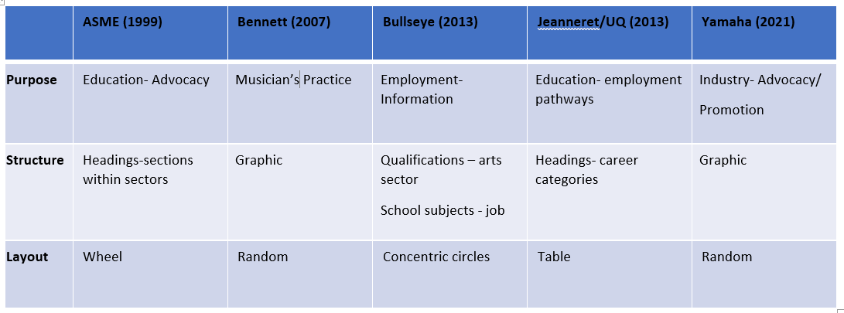
Summary/Comparison

Slide 3
Make Music Work for You (ASME Advocacy Kit, 1999)

Slide 4
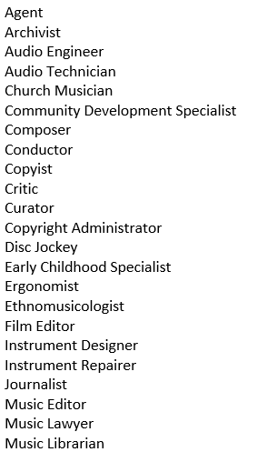
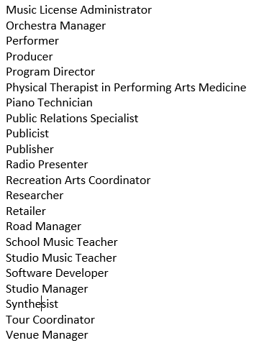
What kind of a musician would you like to be? (Bennett, 2008)

Slide 5
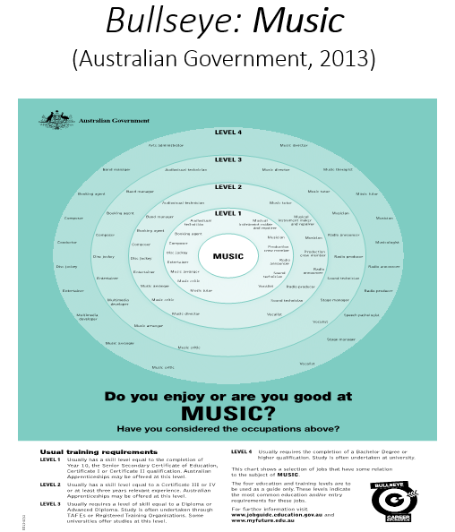
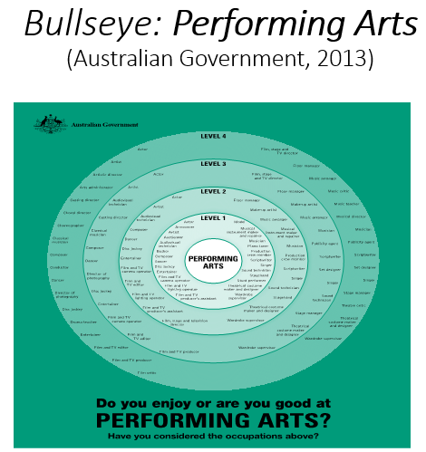
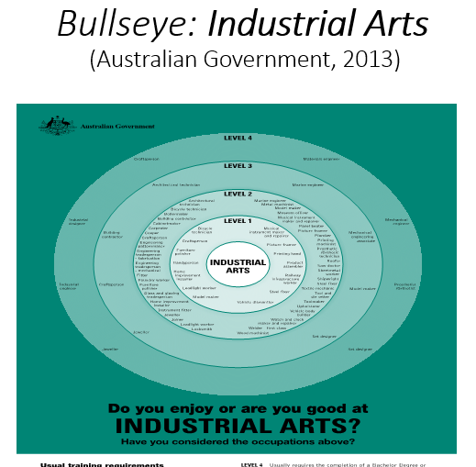
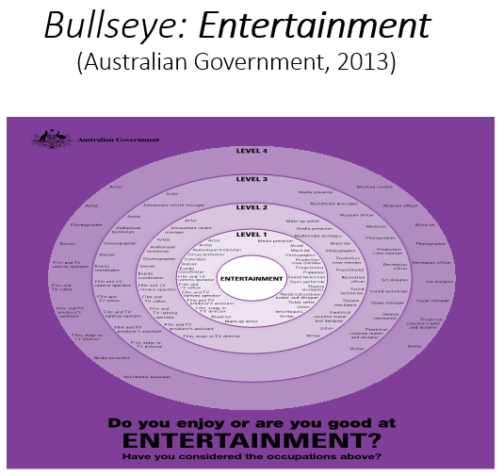

Slide 6
Employment Pathways in Music Jeanneret (2013)
Composition
Performance
Music Education
Writing and Research
Instrumental Making and Repairing
Libraries, Archives and Information Services
Retailing and Wholesaling
Broadcasting
Music Therapy
Production
Arts Administration
Music Business

Slide 7
Careers in Music (Yamaha, 2021)

Slide 8
Community of Practice (spider web = music professionalism)

